Slide 1
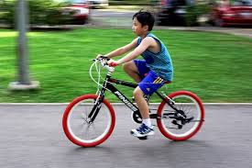
Describing and measuring motion, How do you recognize motion?
An object is in motion when its distance from another object is changing.
Movement depends on your point of view.

Slide 2
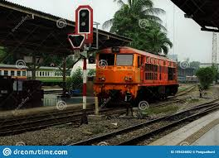
What is called reference point?
A place or an object used for comparison to determine if something is in motion.
An object is in motion if it changes position relative to a reference point.

Slide 3
What are the different types of motions?
Types of Motion
Rectilinear motion
Circular motion
Periodic motion
Rotational motion.

Slide 4
Slow and Fast motion
The slow motion means the movement of object /body with respective to its surrounding but with a relative slower speed.
The fast motion means the movement of object /body with respective to its surrounding but with relative greater speed.

Slide 5
What is Speed?
Speed is the distance travelled per unit of time. It is how an object is moving.

Slide 6
Different Speeds
Uniform speed : If an object covers equal distance in equal interval of time, then time speed graph of an object is a straight line parallel to time axis then body is moving with a uniform speed.
Non-uniform speed : If the speed of a body is changing with respect to time it is moving with a non-uniform speed.
The average speed of an object is the total distance traveled by the object divided by the elapsed time to cover that distance.

Slide 7
Instruments: Speed & Distance
Instrument used to measure Speed is Speedometer
Instrument used to measure distance is An odometer

Slide 8
Assignment
What is motion?
What is called reference point?
What are the different types of motions?
What is Speed?
What are the different speeds?

Slide 9
Stay home, Stay Safe and Stay Balanced.
Thank you
Coming up:
Measurement of time
Distance- time graphs

